Slide 1
Spring Security with JWT

Slide 2
Why is API security important?
REST API security plays a crucial role in modern software and applications.
By their very nature, REST APIs are exposed to the open internet, making them highly susceptible to cyberattacks.
So
Protect sensitive data transferred between services
Safeguard user privacy
Prevent malicious actors from disrupting critical business operations through an attack.

Slide 3
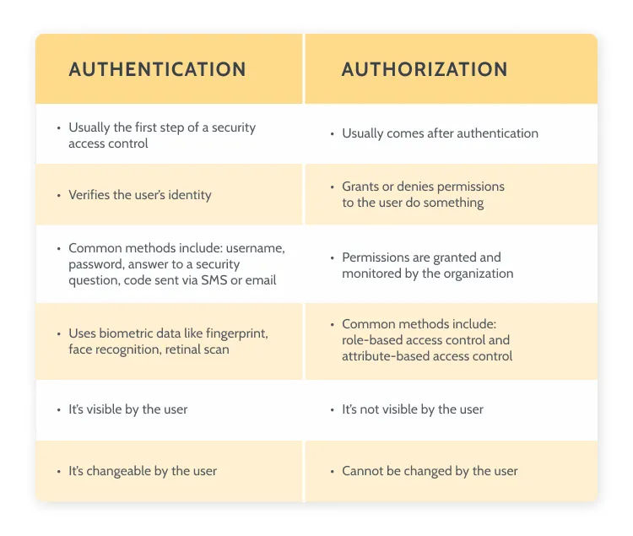
Authentication vs Authorization

Slide 4
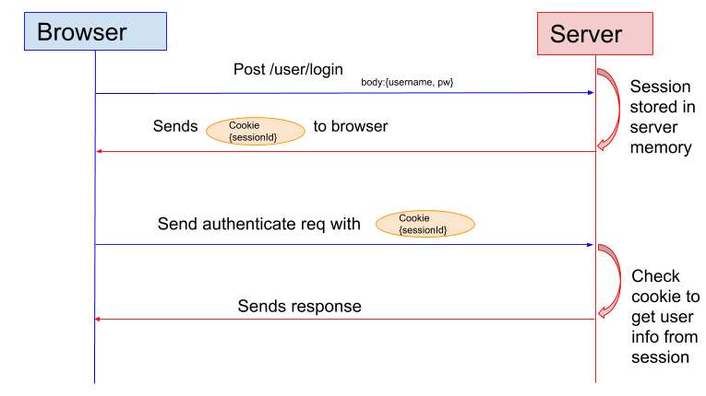
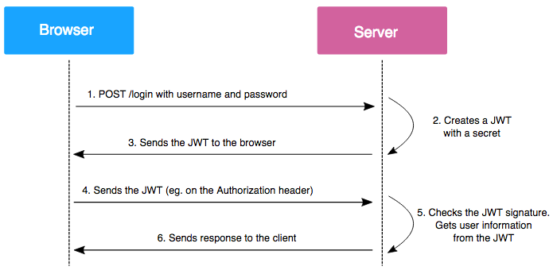
Token vs Session Based Authenication
JWT Based
Session Based

Slide 5
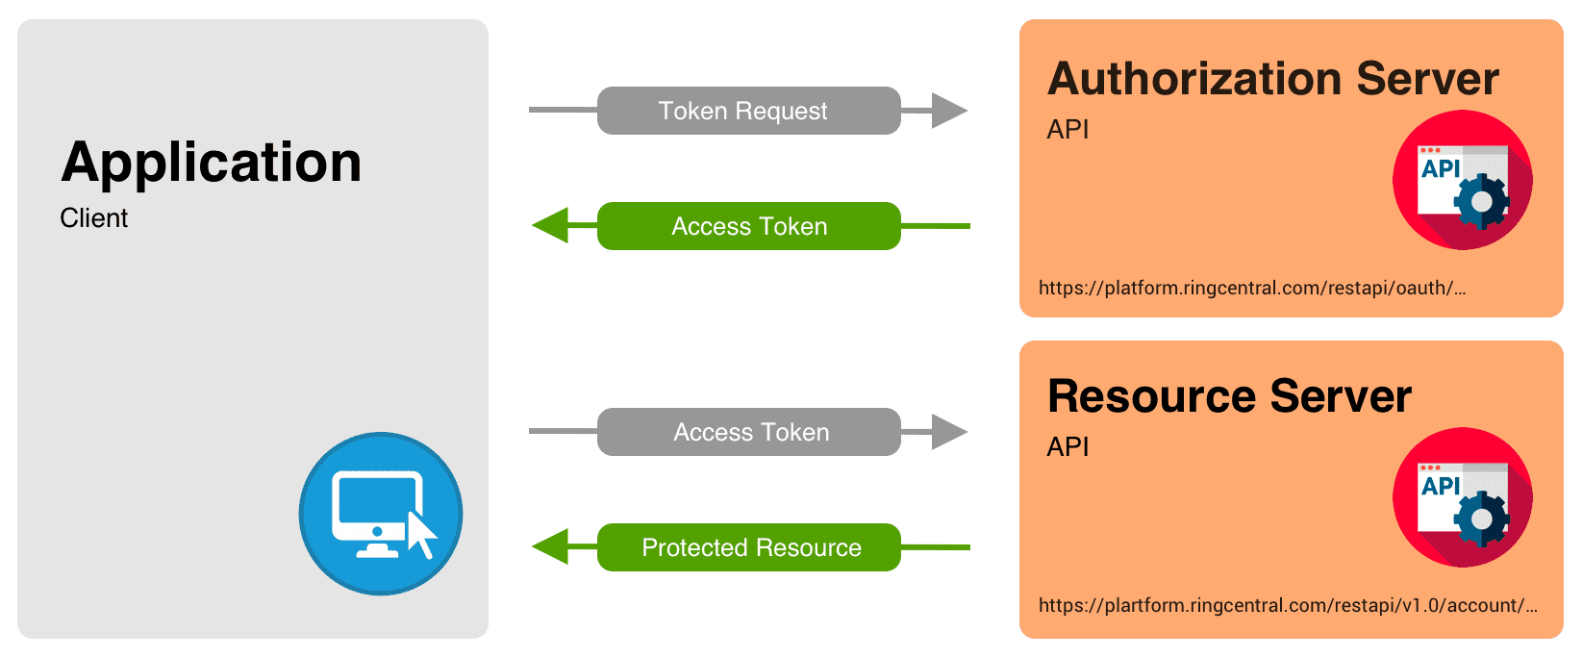
JWT Working

Slide 6
What is JWT?
JSON web token(JWT)
Securely transfer information over the web(between two parties).
Used for an authentication system and information exchange.
The token is mainly composed of header, payload, signature.
These three parts are separated by dots(.).
JWT defines the structure of information we are sending from one party to the another.

Slide 7
JWT Structure
A JWT represents a string in the following format
[header].[payload].[signature]
Header
Describes the cryptographic operations applied to the JWT like signing/decryption technique used on it.
Can also contain the data about the media/content type of the information we are sending.
This information is present as a JSON object then this JSON object is encoded to BASE64URL.
A simple header of a JWT looks like the code below:
{
"typ":"JWT",
"alg":"HS256"
}

Slide 8
JWT Structure
Payload
All the user data is actually added.
This data is also referred to as the ‘claims’ of the JWT.
Information is readable by anyone so do not put any confidential information in here.
This part generally contains user information.
This information is present as a JSON object then this JSON object is encoded to BASE64URL.
We can put as many claims as we want inside a payload,
The JWT with the payload will look something like this:
{
"userId":"b07f85be-45da",
"iss": "https://provider.domain.com/",
"sub": "auth/some-hash-here",
"exp": 153452683
}

Slide 9
JWT Structure
Signature
This is the third part of JWT
Used to verify the authenticity of token.
BASE64URL encoded header and payload are joined together with dot(.)
And it is then hashed using the hashing algorithm defined in a header with a secret key.
This signature is then appended to header and payload using dot(.) which forms our actual token header.payload.signature
Syntax
HASHINGALGO( base64UrlEncode(header)+“.”+base64UrlEncode(payload),secret)

Slide 10
How does a signature ensure authenticity?
A signature can only be created by someone possessing a secret key, and the original payload.
Signatures are generally formed by combining the data to be signed with a secret key
By appending them together and hashing them (HS256), or
By encrypting a representation of that data (a hash) using the secret key (RS256).
HS256
Symmetric signing method
Secret key is shared between the sender and the receiver
RS256
Asymmetric signing method
Sender uses the private key and recipient uses the public key

Slide 11
JWT Structure
To know the structure refer
www.jwt.io

Slide 12
Spring Security

Slide 13
Spring Security
A framework that focuses on providing both authentication and authorization (or access-controls) to Java applications.
Core Concept
Authentication
Validating your credentials like User Name/User ID and password to verify your identity.
The system determines whether you are what you say you are using your credentials.
Authorization
Determine whether the authenticated user has access to particular resources.
It verifies your rights to grant you access to resources such as information, databases, files, etc.
Authorization usually comes after authentication which confirms your privileges to perform.

Slide 14
Spring Boot 3 Security
Spring Boot 3 has lot of changes in the Spring Security module.
Lot of classes are deprecated from the Spring Boot 2.0.
The WebSecurityConfigureAdapter is no longer supported.
In Spring Boot 2
@Configuration
public class SecurityConfiguration extends WebSecurityConfigurerAdapter {
@Override
protected void configure(HttpSecurity http) throws Exception {
http
.authorizeHttpRequests((authz) -> authz
.anyRequest().authenticated()
)
.httpBasic(withDefaults());
}
}

Slide 15
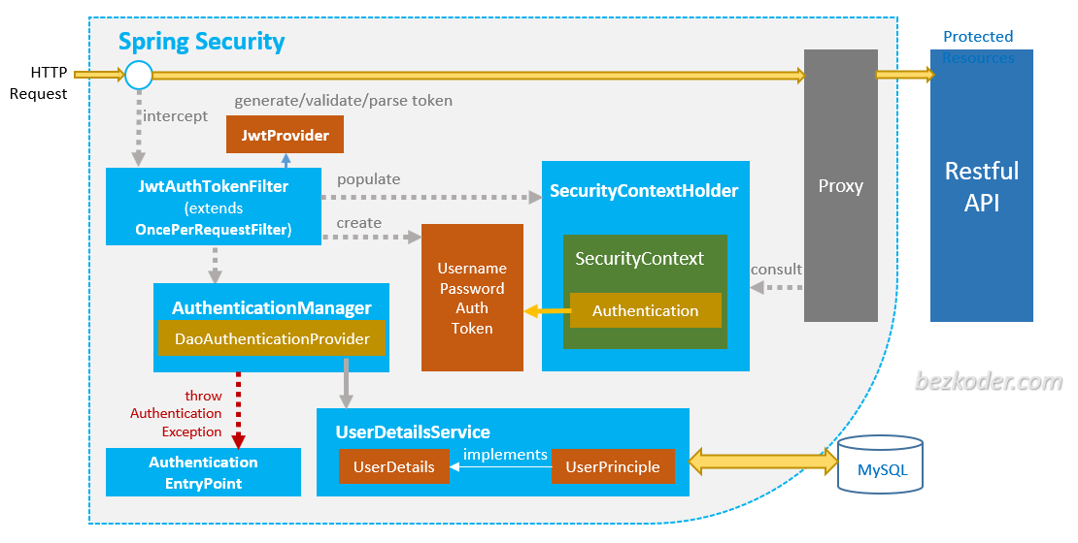
Overall Architecture

Slide 16
Let’s get started…
Add the maven dependency
<dependency>
<groupId>org.springframework.boot</groupId>
<artifactId>spring-boot-starter-security</artifactId>
</dependency>
Start the spring boot application
Access an endpoint.
Prompt for username and password will be asked
Enter “user” as username and for password provide the password given in the console
Now you can access all the endpoints.

Slide 17
1. Configure username/password in application.properties files
Now try to configure the user name and password in application.properties file.
spring.security.user.name=test
spring.security.user.password=test
Now restart the application.
While accessing an endpoint provide username as test and password as test when prompted.
Now you can access all the endpoints.
In application.properties file we can only configure one username and password.
If we need multiple username and password, configure it in a configuration class.

Slide 18
2. Configure username/password in the Configuration class
Create a class SecurityConfig
Annotate it with @Configuration and @EnableWebSecurity
Configure UserDetailsService Bean as follows
@Bean
public UserDetailsService userDetailsService(PasswordEncoder encoder) {
UserDetails admin = User.withUsername("Emma")
.password(encoder.encode("Watson"))
.roles("ADMIN")
.build();
UserDetails user = User.withUsername("user123")
.password(encoder.encode("pass123"))
.roles("USER, ADMIN")
.build();
return new InMemoryUserDetailsManager(admin, user);
}
We return InMemoryUserDetails object as the UserDetails are maintained in-memory

Slide 19
2. Configure username/password in the Configuration class - contd
Keep the passwords encoded
So configure the PasswordEncoder Bean
@Bean
public PasswordEncoder passwordEncoder() {
return new BCryptPasswordEncoder();
}
Pass this to the userDetailsService() method and encode the passwords.

Slide 20
3. Configure secured endpoints in the configuration class
Configure a SecurityFilterChain bean
@Bean
public SecurityFilterChain securityFilterChain(HttpSecurity http) throws Exception {
return http.csrf(csrf -> csrf.disable())
.authorizeHttpRequests(auth -> auth.requestMatchers("/swagger-ui/**","/api/authors/**")
.permitAll()
.anyRequest()
.authenticated())
.formLogin(Customizer.withDefaults())
.build();
}

Slide 21
4. Configure role based authorization to the endpoints
In the controller class specify the role access for each endpoint
@PreAuthorize("hasAuthority(‘ROLE_ADMIN’)")
@PreAuthorize("hasAuthority(‘ROLE_USER’)")
In the SecurityConfig class use @EnableMethodSecurity
Now test the application for role based authorization of endpoints

Slide 22
5. Username/password from DB
Now the usernames/passwords are hardcoded in the UserDetailsService Bean in SecurityConfig class.
But these username/passwords should be in the DB
So create
Entity class
@NoArgsConstructor
@AllArgsConstructor
@Data
@Entity
@Table(name="roles_details")
public class RolesEntity {
@Id
@GeneratedValue(strategy = GenerationType.IDENTITY)
@Column(name="role_id")
private int roleId;
@Column(name="role_name")
private String roleName;
}

Slide 23
5. Username/password from DB - contd
@NoArgsConstructor
@AllArgsConstructor
@Data
@Entity
@Table(name="user_info_details")
public class UserInfoEntity {
@Id
@GeneratedValue(strategy = GenerationType.IDENTITY)
private int id;
private String name;
private String email;
private String password;
@ManyToMany
@JoinTable(name="user_info_roles_details",
joinColumns = @JoinColumn(name="id"),
inverseJoinColumns = @JoinColumn(name="rolesId"))
private List<RolesEntity> allRoles;
}
DaoRepository
@Repository
public interface UserInfoDao extends JpaRepository<UserInfo, Integer>{
Optional<UserInfoEntity> findByName(String name);
}

Slide 24
6. Create UserInfoUserDetailsServiceImpl class
Create a service class UserInfoUserDetailsServiceImpl class that implements UserDetailsService Bean and fetches the names from the DB
@Service
public class UserInfoUserDetailsServiceImpl implements UserDetailsService{
@Autowired
UserInfoDao userInfoDao;
@Override
public UserDetails loadUserByUsername(String username) throws UsernameNotFoundException {
Optional<UserInfoEntity> userInfoEntity = userInfoDao.findByName(username);
// but we have return UserDetails and not UserInfoEntity
return userInfoEntity
.map((userInfo)->new UserInfoUserDetails(userInfo.getName(), userInfo.getPassword(), userInfo.getAllRoles()))
.orElseThrow(()-> new UsernameNotFoundException(username + " not found"));
}
}

Slide 25
7. Create UserInfoUserDetails class
This class will help us convert UserInfo to UserDetails
Because we have to return UserDetails and not UserInfo
public class UserInfoUserDetails implements UserDetails{
private String name;
private String password;
private List<SimpleGrantedAuthority> allRoles;
public UserInfoUserDetails(String name, String password, List<RolesEntity> allRoles) {
super();
this.name = name;
this.password = password;
this.allRoles = allRoles.stream().map((role)-> new SimpleGrantedAuthority(role.getName())).toList();
}
@Override
public Collection<? extends GrantedAuthority> getAuthorities() {
return allRoles;
}
@Override
public String getPassword() {
return password;
}
@Override
public String getUsername() {
return name;
}
}

Slide 26
8.UserDetailsService Bean
Change the UserDetailsService bean
@Bean
public UserDetailsService userDetailsService() {
// UserDetails admin = User.withUsername("Emma")
// .password(encoder.encode("Watson"))
// .roles("ADMIN")
// .build();
// UserDetails user = User.withUsername("user123")
// .password(encoder.encode("pass123"))
// .roles("USER")
// .build();
// return new InMemoryUserDetailsManager(admin, user);
return new UserInfoUserDetailsServiceImpl();
}
Add some users and roles in the DB and test the endpoints

Slide 27
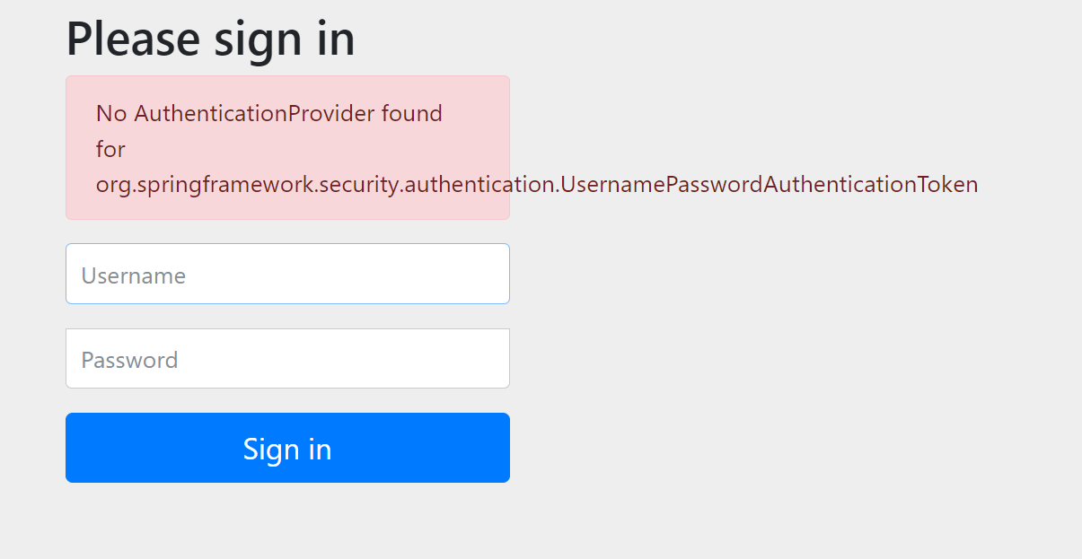
No AuthenticationProvider

Slide 28
Fix
AuthenticationProvider should be configured to talk to the UserDetailsServiceImpl
Configure the AuthenticationProvider Bean in SecurityConfig
@Bean
public AuthenticationProvider authenticationProvider() {
DaoAuthenticationProvider authenticationProvider = new DaoAuthenticationProvider();
authenticationProvider.setUserDetailsService(userDetailsService());
authenticationProvider.setPasswordEncoder(passwordEncoder());
return authenticationProvider;
}

Slide 29
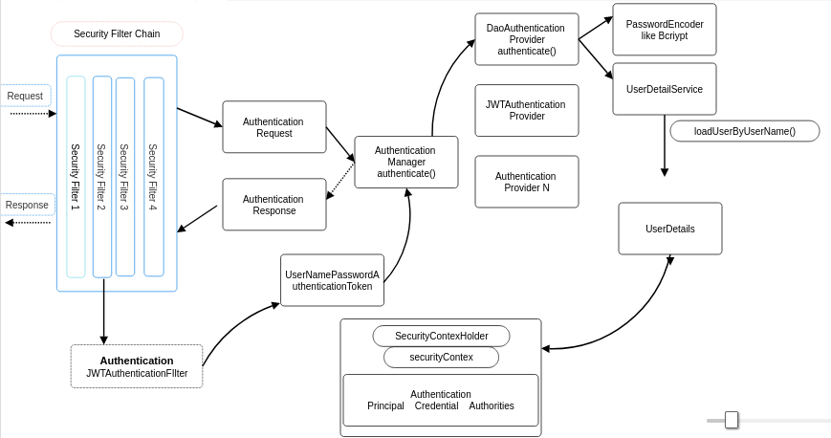
Deep Dive

Slide 30
Introducing JWT
Steps
Add Maven Dependencies
Create JwtService
Create AuthenticationController
Create JwtAuthFilter
Configure the JwtAuthFilter in SecurityConfig
Test the /validate endpoint and other endpoints

Slide 31
Add JWT maven dependencies
Add the maven dependencies
<dependency>
<groupId>io.jsonwebtoken</groupId>
<artifactId>jjwt-api</artifactId>
<version>0.11.5</version>
</dependency>
<dependency>
<groupId>io.jsonwebtoken</groupId>
<artifactId>jjwt-impl</artifactId>
<version>0.11.5</version>
</dependency>
<dependency>
<groupId>io.jsonwebtoken</groupId>
<artifactId>jjwt-jackson</artifactId>
<version>0.11.5</version>
</dependency>

Slide 32
Create JwtService
Create a class call JwtService and annotate it with @Component
public static final String SECRET = "5367566B59703373367639792F423F4528482B4D6251655468576D5A71347437";
public String extractUsername(String token) {
return extractClaim(token, Claims::getSubject);
}
public Date extractExpiration(String token) {
return extractClaim(token, Claims::getExpiration);
}
public <T> T extractClaim(String token, Function<Claims, T> claimsResolver) {
final Claims claims = extractAllClaims(token);
return claimsResolver.apply(claims);
}

Slide 33
Create JwtService contd
private Claims extractAllClaims(String token) {
return Jwts
.parserBuilder()
.setSigningKey(getSignKey())
.build()
.parseClaimsJws(token)
.getBody();
}
private Boolean isTokenExpired(String token) {
return extractExpiration(token).before(new Date());
}
public Boolean validateToken(String token, UserDetails userDetails) {
final String username = extractUsername(token);
return (username.equals(userDetails.getUsername()) && !isTokenExpired(token));
}

Slide 34
Create JwtService contd
public String generateToken(String userName){
Map<String,Object> claims=new HashMap<>();
return createToken(claims,userName);
}
private String createToken(Map<String, Object> claims, String userName) {
return Jwts.builder()
.setClaims(claims)
.setSubject(userName)
.setIssuedAt(new Date(System.currentTimeMillis()))
.setExpiration(new Date(System.currentTimeMillis()+1000*60*30))
.signWith(getSignKey(), SignatureAlgorithm.HS256).compact();
}
private Key getSignKey() {
byte[] keyBytes= Decoders.BASE64.decode(SECRET);
return Keys.hmacShaKeyFor(keyBytes);
}

Slide 35
Create AuthenticationController
@RestController
@RequestMapping("/api")
public class AuthenticationController {
@Autowired
private AuthenticationManager authenticationManager;
@Autowired
private JwtService jwtService;
@PostMapping("/validate")
public String validate(@RequestBody UserInfoEntity userInfo){
Authentication authentication = authenticationManager.authenticate(new UsernamePasswordAuthenticationToken(userInfo.getName(), userInfo.getPassword()));
if (authentication.isAuthenticated()) {
return jwtService.generateToken(userInfo.getName());
} else {
throw new UsernameNotFoundException("invalid user request !");
}
}
}

Slide 36
Create JwtAuthFilter
The JwtAuthFilter will intercept all the incoming request to verify the token
Create a class called JwtAuthFilter and extend OncePerFilter, annotate it with @Component
override the doFilterInternal() method.

Slide 37
Create JwtAuthFilter contd
@Component
public class JwtAuthFilter extends OncePerRequestFilter {
@Autowired
private JwtService jwtService;
@Autowired
private UserInfoUserDetailsServiceImpl userDetailsService;
@Override
protected void doFilterInternal(HttpServletRequest request, HttpServletResponse response, FilterChain filterChain) throws ServletException, IOException {
String authHeader = request.getHeader("Authorization");
String token = null;
String username = null;
if (authHeader != null && authHeader.startsWith("Bearer ")) {
token = authHeader.substring(7);
username = jwtService.extractUsername(token);
System.out.println("username : " + username);
}
if (username != null && SecurityContextHolder.getContext().getAuthentication() == null) {
UserDetails userDetails = userDetailsService.loadUserByUsername(username);
if (jwtService.validateToken(token, userDetails)) {
System.out.println("token validated...");
UsernamePasswordAuthenticationToken authToken = new UsernamePasswordAuthenticationToken(userDetails, null, userDetails.getAuthorities());
authToken.setDetails(new WebAuthenticationDetailsSource().buildDetails(request));
SecurityContextHolder.getContext().setAuthentication(authToken);
}
}
filterChain.doFilter(request, response);
}
}

Slide 38
Include JwtAuthFilter in SecurityConfig
In SecurityConfig class autowire JwtAuthFilter
And configure the filter in the SecurityFilterChain
@Bean
public SecurityFilterChain securityFilterChain(HttpSecurity http) throws Exception {
return http.csrf(csrf -> csrf.disable())
.authorizeHttpRequests(auth -> auth.requestMatchers("/swagger-ui/**","/api/authors/**","/api/validate")
.permitAll()
.anyRequest()
.authenticated())
.formLogin(Customizer.withDefaults())
.addFilterBefore(authFilter, UsernamePasswordAuthenticationFilter.class)
.build();
}

Slide 39
Test the /validate endpoint
From postman, test the /validate endpoint and give the username and password in the requestbody
The server will validate and give a JWT token upon successful validation
For subsequent endpoint requests sent, attach this token in the request header as
Authorization : Bearer <jwt token>

Slide 40
END

